Slide 1

Instructor Kick-off
Analyze A/B Test Results
© 2019 Udacity. All rights reserved.

Slide 2
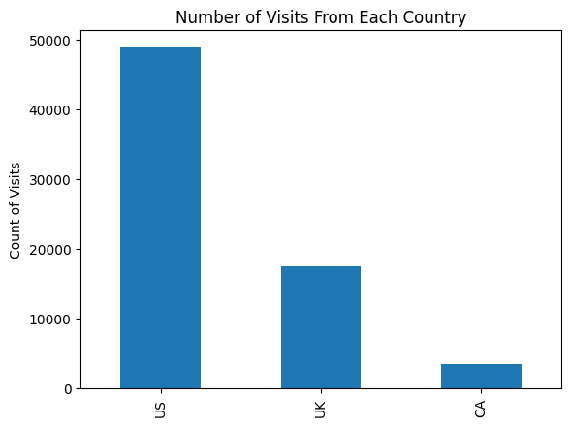
How Was The Experiment Implemented?​
Total Visitors: 69889
Total Treatment Participants: 35211
Total Control Participants: 34678​

Slide 3
Conversion Rates
 | U.S. | U.K. | CA
Control | 10.7% | 10.2% | 9.4%
Treatment | 15.8% | 14.9% | 15.4%
Executive Summary: The probabilities suggest no association between “Country” and conversion rates but a positive impact of “Treatment” on conversion rates, i.e. the rate of users who decide to pay for the company's product.

Slide 4
Experiment Results
Treatment Conversion Rate: 13.0%
Control Conversion Rate: 12.8%
Delta in Treatment vs. Control Conversion Rate: 0.0017
p-value: 0.0
Conclusion: As the p-value is smaller than the Type I error rate of 0.05, we have statistically significant evidence to reject the null hypothesis, that is the treatment page has better conversion rate than the control page.

Slide 5
Country Results
Conclusion: There is no statistically significant difference in conversion rates between countries as the p-values of UK and US (0.978 and 0.207, respectively) are greater than the preset Type I error (0.05).

